Slide 1
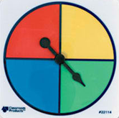
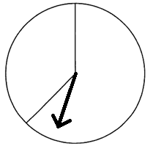
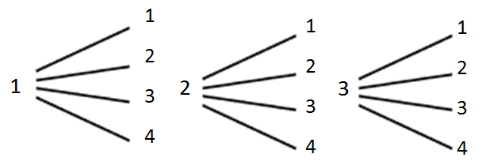
Data Management & Probability
Option 1: Use a tree diagram to show that the probability of spinning a 3 on each spinner (together) is 1/6?
Option 2: A tree diagram describing what happened when spinning two spinners is shown below. What did the two spinners look like?
1
4
2
3
2
3

